Slide 1
API
(Application Programming Interface)
Er. Bipin Thapa

Slide 2
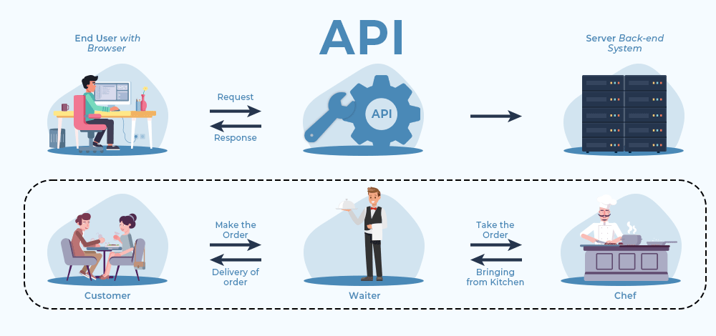

Slide 3
API
It's a software interface that allows two different applications to communicate.
Two terms:
Client: The client send the request.
Server: The application which send the response is called the server

Slide 4
Rest API
(Representative State Transfer)
New as well

Slide 5
Advantages of Rest API
These are the most popular and flexible APIs found on the web today. The client sends requests to the server as data.
Clients and servers exchange data using HTTP. JSON, XML
REST defines a set of functions like getting, PUT, DELETE, GET, POST, etc
REST has SSL and HTTPS for security.
API call can be cashed
Required few resources and consume less bandwidth

Slide 6
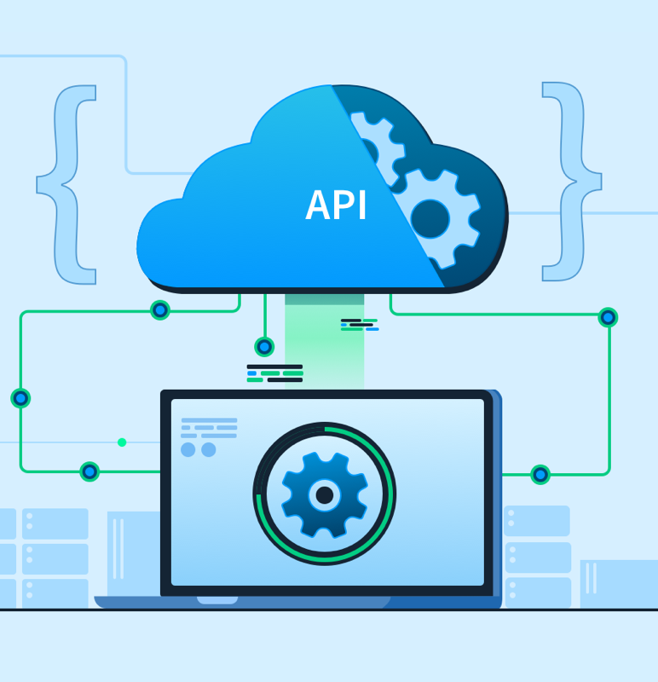
Set of Functions
It defines a set of functions (GET, PUT, POST, DELETE) that clients use to access server data.
The functions used are:
GET (retrieve a record)
PUT (update a record)
POST (create a record)
DELETE (delete the record)

Slide 7
Different codes in API
200 OK,
201 Created
202 Accepted

Slide 8
Client Error
400 Bad Request: the request could not be understood by the server due to incorrect syntax. (e.g. if you try to call DELETE client without the id).
401 Unauthorized. the request requires user authentication information, Invalid auth (bad username/password)
403 Forbidden: The client does not have access rights to the content
404 The server can not find the requested resource.
405 Method Not Allowed:
429 Too Many Requests

Slide 9
Server Error
500 Internal Server Error: server encountered an unexpected condition that prevented it from fulfilling the request.
501: HTTP method is not supported by the server and cannot be handled.
502 Bad Gateway: The server got an invalid response (Service offline, system down)
503 Service Unavailable: The server is not ready to handle the request.
504: Gateway Timeout: The server is acting as a gateway and cannot get a response in time for a request.
511: Network Authentication Required: indicates that the client needs to authenticate to gain network access

Slide 10
API ENDPOINTS
This is the final touchpoints in the API communication system. URLs, services, and other specific digital locations from where information is sent and received between systems

